Slide 1


SOCIOGRAPHY
-MADE BY VADIK AMAR(20BCS2872)

Slide 2

GROUP MENTORS
Er. Priyanka Rawat and Er. Palwinder Kaur Mangat

Slide 3

About Sociography
Sociography is a social networking web service designed with the help of front end- html, css and javascript and back end- sql, php. The sql and php will connect to a database to keep the records of the systems. Html is used to give structure, css is used to style and to decorate, and javascript is for functioning of website.

Slide 4


TECHNOLOGY USED
HTML, CSS, JS, SQL

Slide 5


Software Requirements
VS Code, Xampp AND Mozilla Firefox

Slide 6
Project Design
1. Login , Signup, Contact Page
2. Home page
3. Profile of user

Slide 7

Home Layout

Slide 8
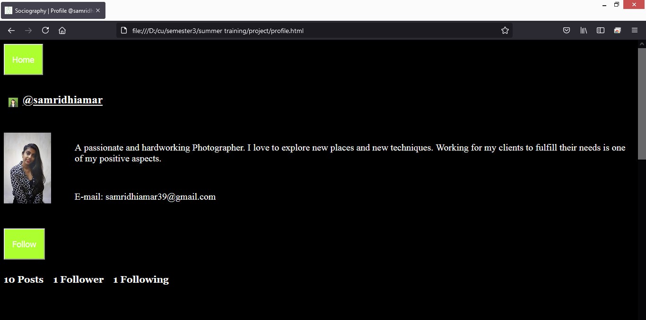
Profile Layout

Slide 9
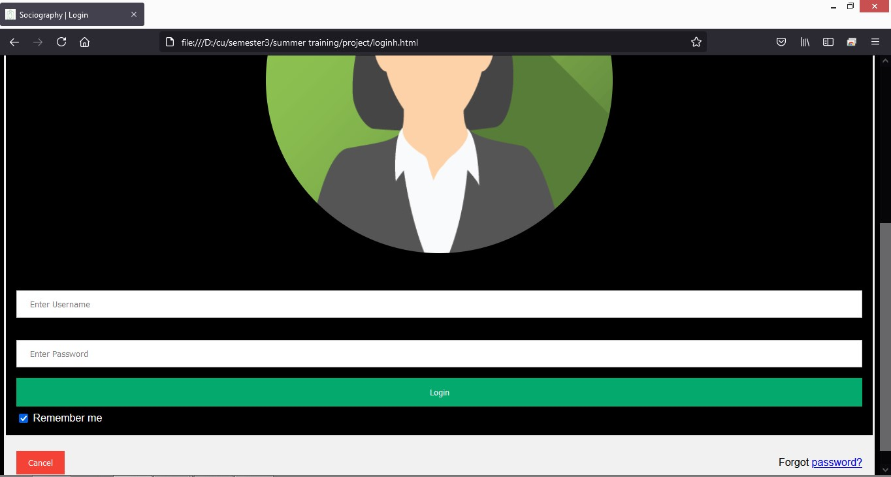
Login Layout

Slide 10

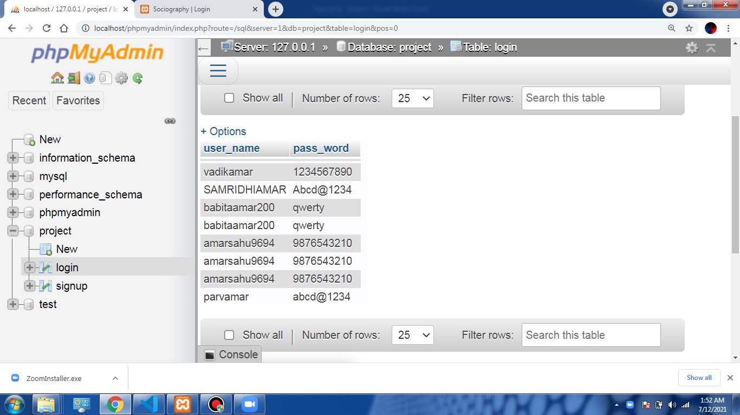
Login Database

Slide 11

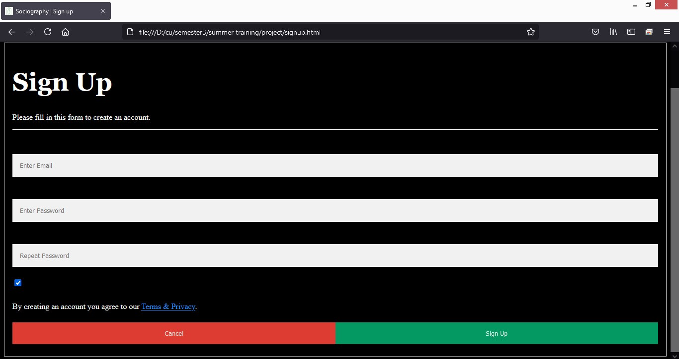
Signup Layout

Slide 12
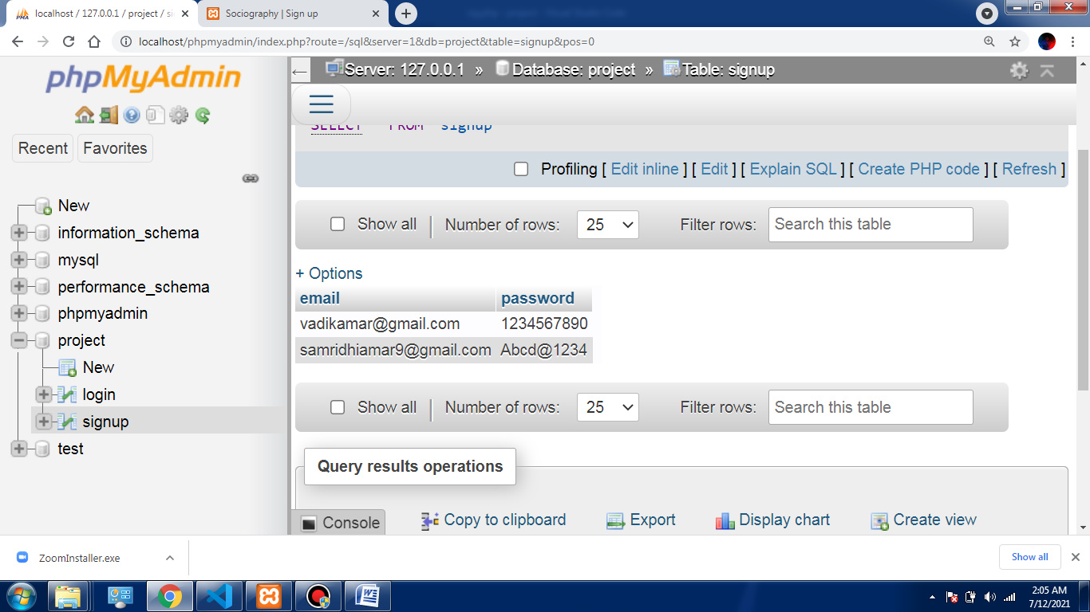
Signup Database

Slide 13
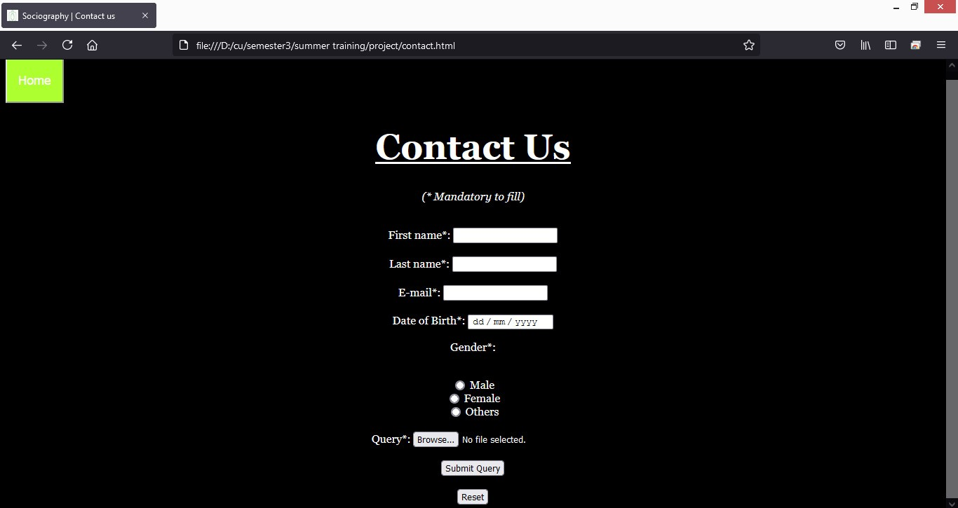
Contact Layout

Slide 14
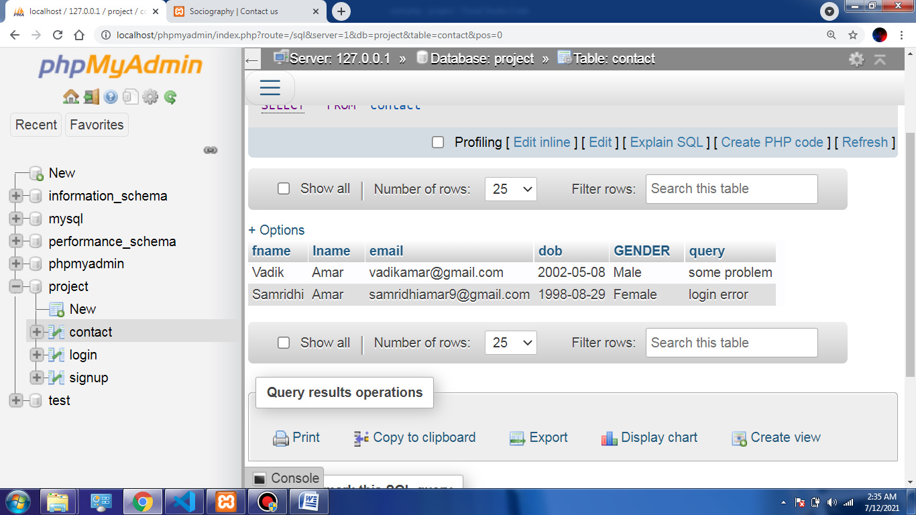
Contact Database

Slide 15
APPLICATIONS
People can hire photographers for their purposes.
Top user/photographer can appear on the home page.
Photographers can express themselves and also can keep an eye on their competitors.
Simple design, easy to use interface.

Slide 16
REFERENCES
Wikipedia: - https://www.wikipedia.org/
For paragraph on photography
W3School: - https://www.w3schools.com/
For html, css and js
YouTube :- https://www.youtube.com/
For installing softwares
Stackoverflow: - https://stackoverflow.com/
For queries

Slide 17


